Slide 1
How to command an AV to drive based on a trajectory in SUMO
Wushuang Bai

Slide 2
The purpose of this presentation is to show how to command an AV to drive based on a trajectory.

Slide 3
A test was performed with the goal to command an AV based on a trajectory in SUMO
Input:
Commanded trajectory containing x and y in meters
Source data file: commandTrajectoryInput.csv
Output:
Actual trajectory containing x and y in meters.
Source data file: commandTrajectoryOutput.csv
Script used:
script_testFcn_fcn_CommandVehTrajectory.py
fcn_CommandVehTrajectory.py
Other data files used:
hello.sumocfg - this runs the simulation
hello.net.xml - this describes SUMO road network
hello.rou.xml - this describes simulation route
hello.settings.xml - this describes simulation settings such as simulation delay

Slide 4
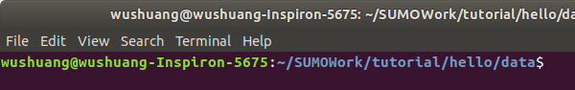
Step 1. Navigate to the folder of data files and script, open a terminal.

Slide 5
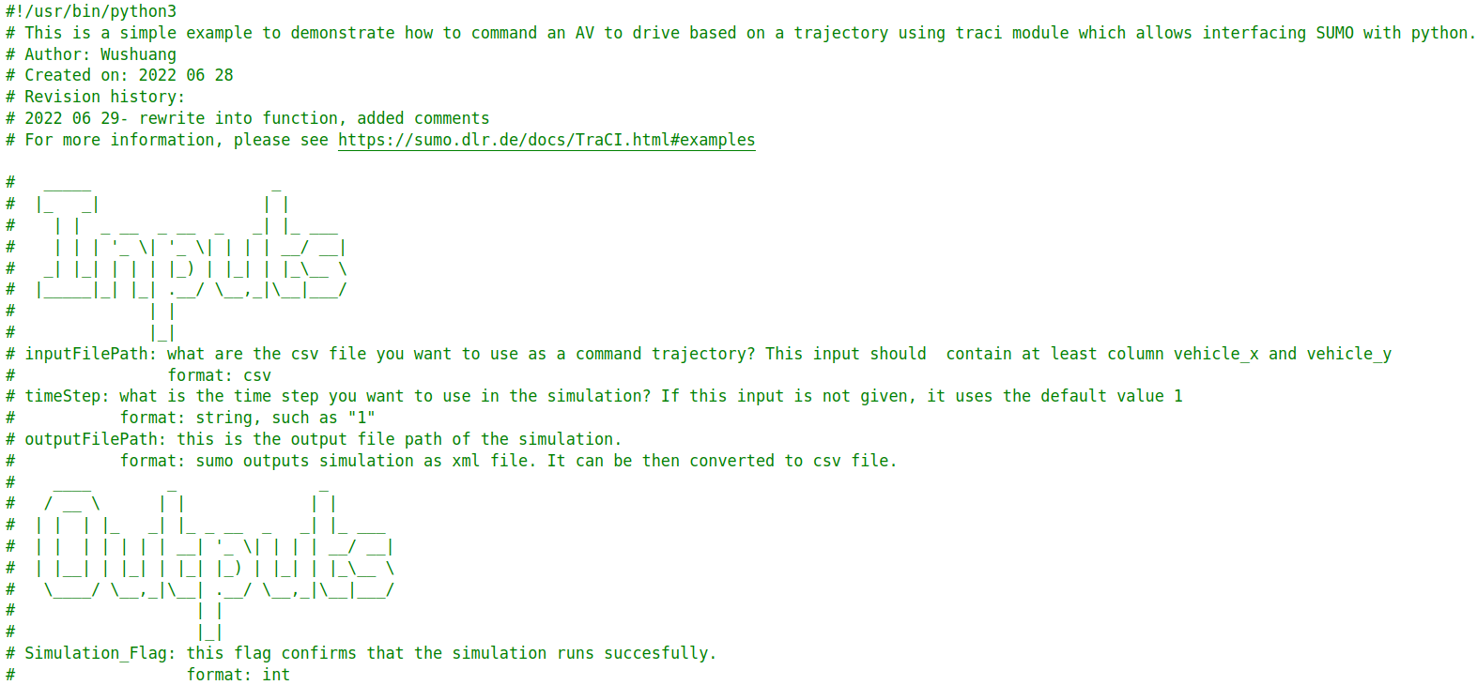
Step 2. Run the script by running command "python3 script_testFcn_fcn_CommandVehTrajectory.py". This script calls the function fcn_CommandVehTrajectory.py, which calls SUMO using python API, takes user's input of commanded trajectory in x and y, and run the simulation.

Slide 6
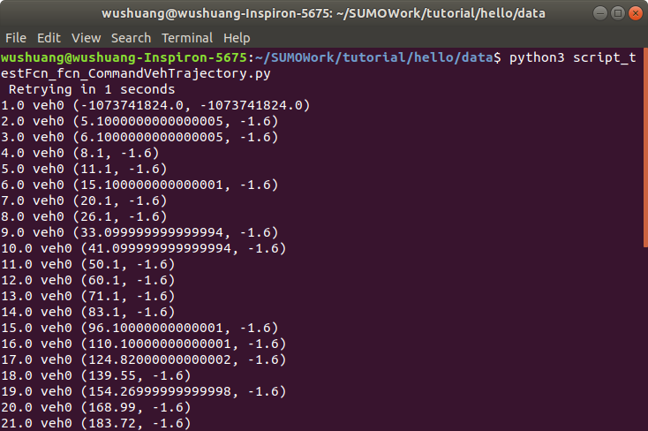
Step 2. Run the script by running command "python3 script_testFcn_fcn_CommandVehTrajectory.py". This script calls the function fcn_CommandVehTrajectory.py, which calls SUMO using python API, takes user's input of commanded trajectory in x and y, and run the simulation.

Slide 7
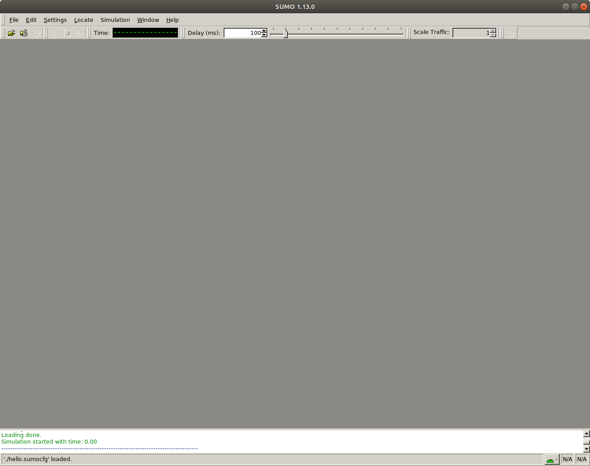
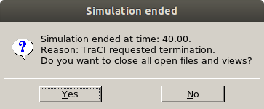
Step 3. Close SUMO to end the script. Please note that you have to close SUMO to end the script so that output file can be written.

Slide 8
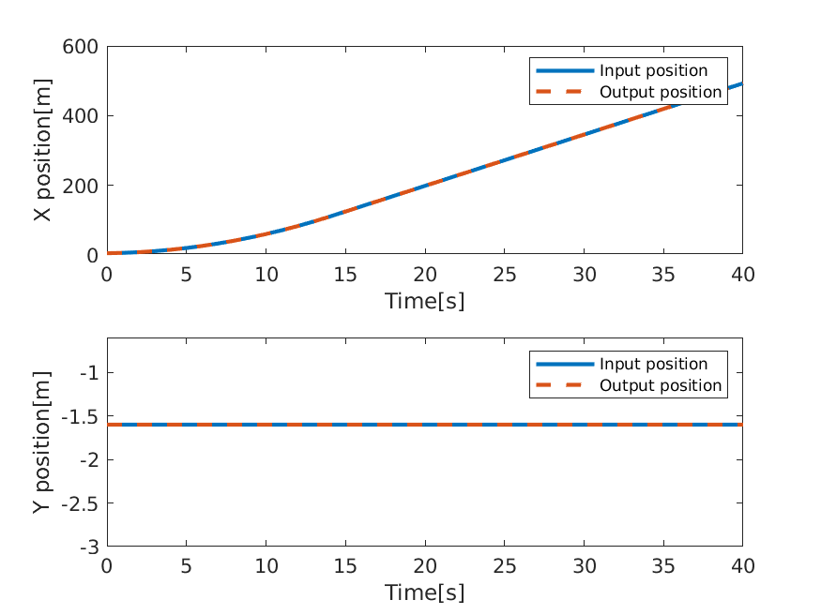
Step 4. Investigating the results. In this example, input trajectory is a straight line. The results show that the actual output trajectory matches the input trajectory. Please note that the output file is in xml format. For how to convert it from xml to csv,please see the document "How to export SUMO simulation results.pptx"

Slide 9
Files used in this document can be found:
Data files can be found: https://github.com/ivsg-psu/TrafficSimulators_GettingStartedWithDifferrentSimulators_GettingStartedWithSUMO/tree/main/Data/HelloSUMO
Script can be found: https://github.com/ivsg-psu/TrafficSimulators_GettingStartedWithDifferrentSimulators_GettingStartedWithSUMO/tree/main/Code
For more information, please see:
https://sumo.dlr.de/docs/TraCI.html
https://sumo.dlr.de/docs/TraCI/Change_Vehicle_State.html

